Slide 1

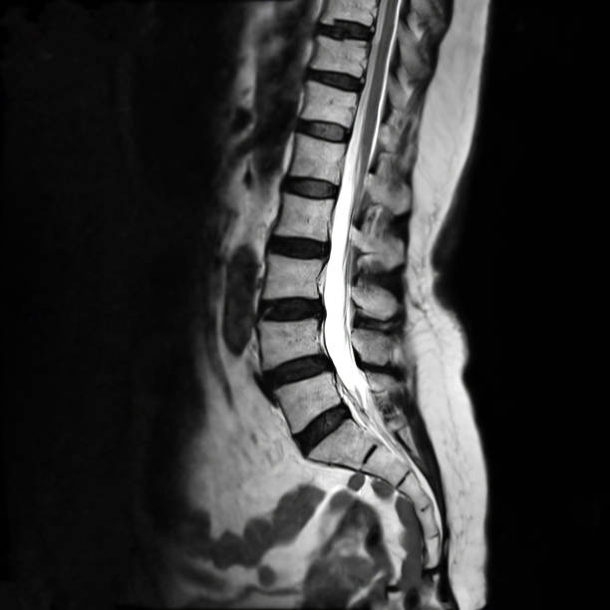
Detection of abnormalities in the human vertebral column.
SRM INSTITUTE OF SCIENCE AND TECHNOLOGY
SCHOOL OF COMPUTING
DEPARTMENT OF COMPUTING TECHNOLOGIES
18CSP107L / 18CSP108L - MINOR PROJECT / INTERNSHIP
Batch ID: B249
Student 1 Reg. No: RA2011003010183
Student 1 Name: Aditya Singh Solanki
Student 2 Reg. No: RA2011003010205
Student 2 Name: Arpan Ghosh
Guide name: Dr. Padmapriya G
Designation: Associate Professor
Department: CTECH

Slide 2
Introduction
What is the Spinal Cord and the Vertebral Column?
The spinal cord is a long, tube-like structure in your back that carries messages between your brain and the rest of your body, allowing you to move and feel things.
The spinal cord is a vital part of the central nervous system.
The vertebral column, also known as the spine or backbone, is a series of individual bones (vertebrae) stacked on top of each other, forming a flexible and protective structure along your back.
It provides support for the body, protects the spinal cord, and allows movement of the torso, including bending, twisting, and turning.

Slide 3
Problem Statement
The aim of this project is to develop a system that can accurately detect abnormalities in the human vertebral column, specifically identifying whether an X-ray image represents a normal or fractured condition. We will use Support Vector Machines (SVM) and Logistic Regression, two well-established machine learning techniques, to analyze a dataset of spine images. By training and evaluating these models, we intend to provide a reliable tool for assisting medical professionals in diagnosing vertebral column conditions, thereby contributing to improved patient care and treatment."

Slide 4
Objectives
Read Image Input
Split image data into training and testing data.
Train the SVM model to classify spine X-ray images as normal or fractured.
Train the Logistic Regression model to classify spine X-ray images as normal or fractured.
Now test the model using the testing data.
Evaluate model performance using accuracy, precision.
Display the results.
Continuously improve the model.
Ensure ethical and data privacy compliance.

Slide 5
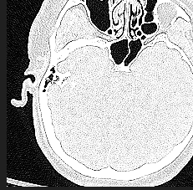
Abstract
This project aims to detect the presence of abnormalities(fractures) in the vertebral column.
As the vertebral column and the spine are vital and critical regions of the human body, damages to these that are left untreated can cause severe complications in the long run.
Hence, our project aims to detect fractures of the vertebral column so that the patient can get timely treatment and prevent severe complications.

Slide 6
Abstract (Continued)
The learning algorithms we are using in our project to train our model are the Support Vector Machine (SVM) and the Logistic Regression (LR) algorithms.
Our dataset basically is an image dataset that consists of images of the vertebral column from the top view, and the images belong to two classes either Fracture or Normal.
We have taken our entire dataset from Kaggle and have split the entire dataset into train (training data) and val (testing data) folders which internally contain the fracture and the normal images.
We have used 80% of our total dataset for training and the remaining 20% for testing our models.

Slide 7
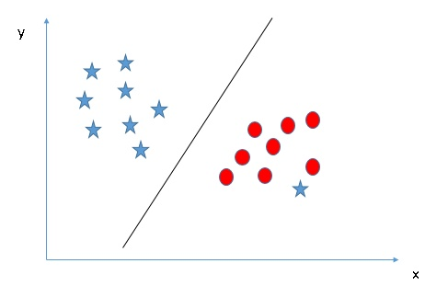
More about our Models
SVM
SVM: Support Vector Machine is a machine learning algorithm.
Binary Classification: SVM is often used for binary classification, where it separates data into two categories.
Margin: SVM finds the best line or hyperplane that maximizes the margin (distance) between two classes.
Support Vectors: These are the data points closest to the decision boundary.
Kernel Trick: SVM can handle complex, non-linear data by using a kernel function to transform it.
Effective for High Dimensions: It works well in high-dimensional spaces, like text or image data.
Regularization: SVM can handle outliers and prevent overfitting with a regularization parameter.
Versatile: SVM is used in diverse applications, from text and image classification to finance and biology.

Slide 8
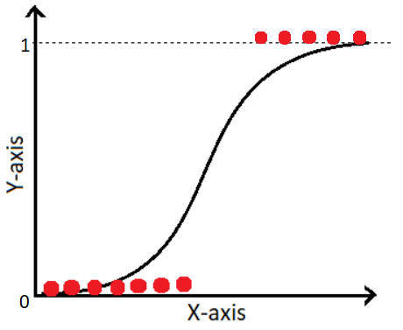
More about our Models
Logistic Regression
Classification Algorithm: Logistic Regression is a statistical method used for classification, not regression despite its name.
Binary Classification: It's commonly used for binary classification problems, where data is categorized into two classes, such as "yes" or "no."
Logistic Function: It uses the logistic (sigmoid) function to transform input data into values between 0 and 1, representing probabilities.
Linear Decision Boundary: Logistic Regression creates a linear decision boundary that separates the classes.
Probability Estimation: It provides the probability that a data point belongs to a particular class.

Slide 9
Literature Review
Manual Diagnosis Challenge: Traditional vertebral fracture diagnosis relies on manual, time-consuming processes.
Automated Approaches:
SVM (Support Vector Machine): Offers strong separation capabilities; well-suited for binary classification tasks.
Logistic Regression: Provides probabilistic output, facilitating probability-based diagnosis and classification.
Challenges in Vertebral Fracture Detection:
Image Variability: Medical images exhibit variations in quality and patient populations, posing a challenge for consistent diagnosis.
Class Imbalance: Ensuring balanced datasets for training models is crucial to prevent bias and improve classification accuracy.

Slide 10
Literature Review (Contd.)
Real-time Processing: Enhancing processing speed is essential to enable efficient and practical real-time diagnosis.
Overview of Previous Studies:
Numerous studies have been conducted to improve the accuracy and efficiency of vertebral column abnormality detection.
Prior research has employed a range of techniques, including traditional image processing, machine learning, and deep learning.
Key findings and methodologies from previous studies have influenced the development of automated detection systems.
Advancements in image analysis techniques have been pivotal in improving accuracy and efficiency for vertebral column abnormality detection.

Slide 11
Existing Methods
1. Manual Assessment: -
Merits: Relies on clinical expertise, customization, and historical context.
Demerits: Subjectivity, time-consuming, prone to human error.
2. Rule-Based Systems: -
Merits: Automation, structured approach, consistency.
Demerits: Limited flexibility, reliance on rule design, limited accuracy.
3. Machine Learning Approaches
Merits: Automation with precision, data-driven learning, potential for high accuracy.
Demerits: Data dependency, complexity, potential lack of interpretability.

Slide 12
Existing Methods (Contd.)
4. Deep Learning Models: -
Merits: Highly accurate, automatic feature extraction, generalization.
Demerits: Data-hungry, high computational resources required, interpretability challenges.
5. Complexity: -
Traditional and rule-based methods are relatively simpler to implement.
Machine learning and deep learning models require complex design, training, and fine-tuning.
6. Accuracy: -
Machine learning and deep learning models, especially CNNs, can achieve state-of-the-art accuracy.
Traditional and rule-based systems may not reach comparable accuracy levels.

Slide 13
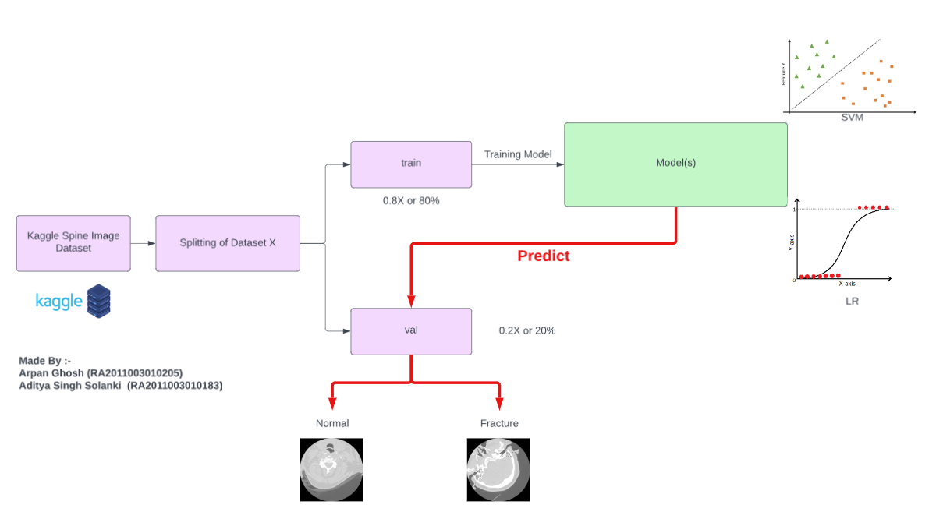
Architecture Diagram

Slide 14
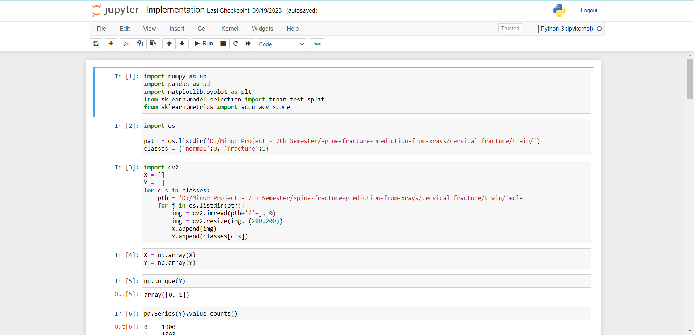
Implementation

Slide 15
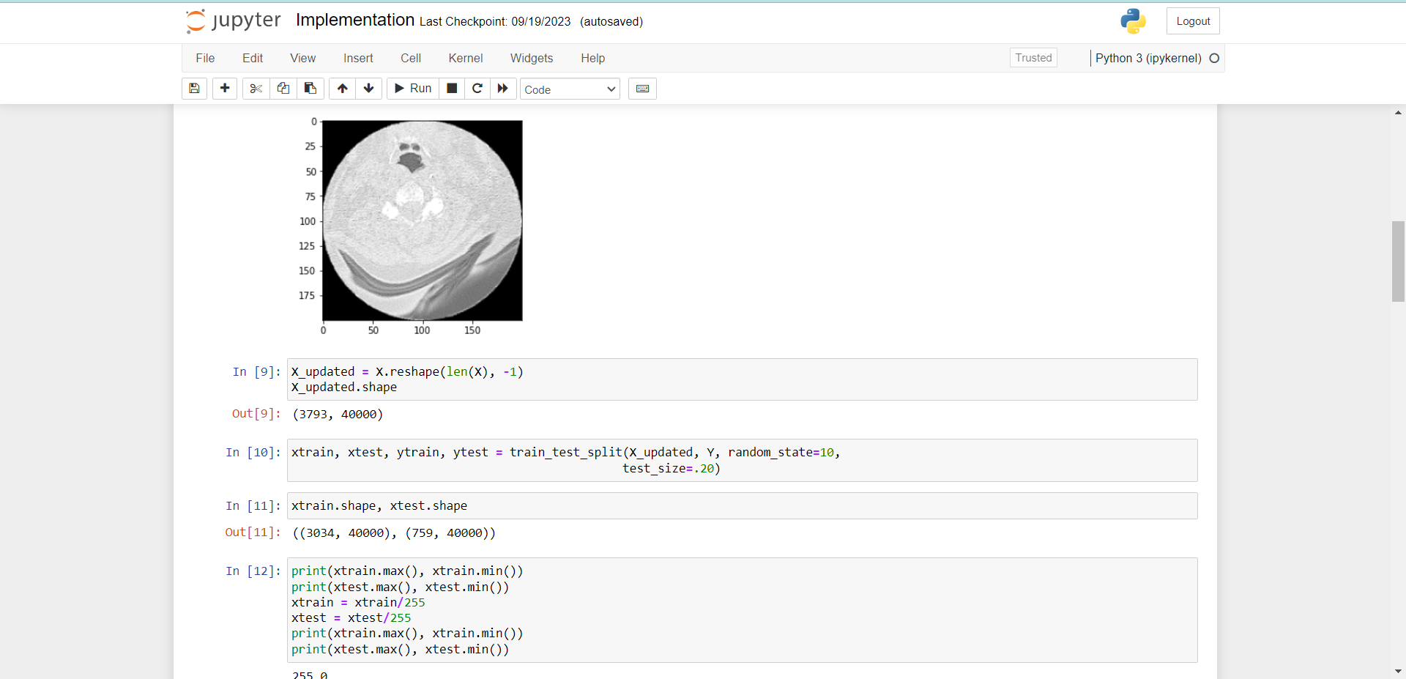
Implementation(Contd.)

Slide 16
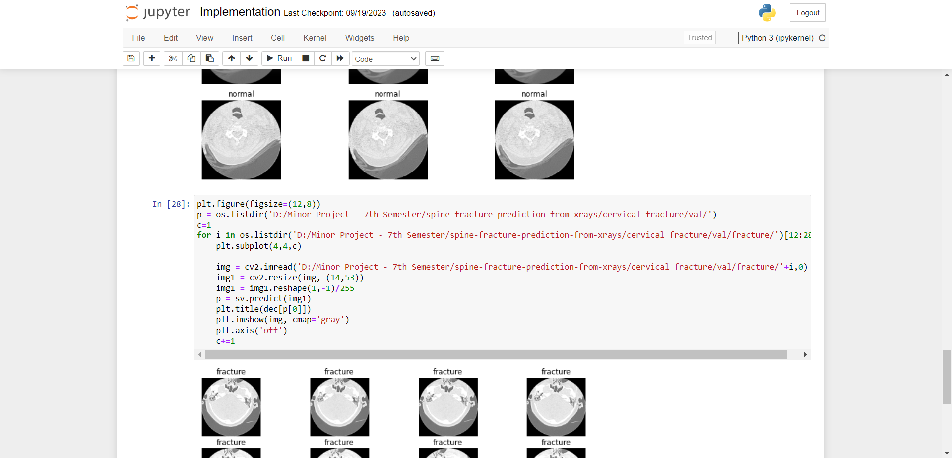
Implementation(Contd.)

Slide 17
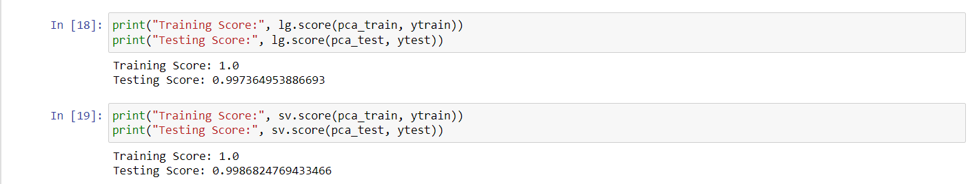
Output and Visualization

Slide 18
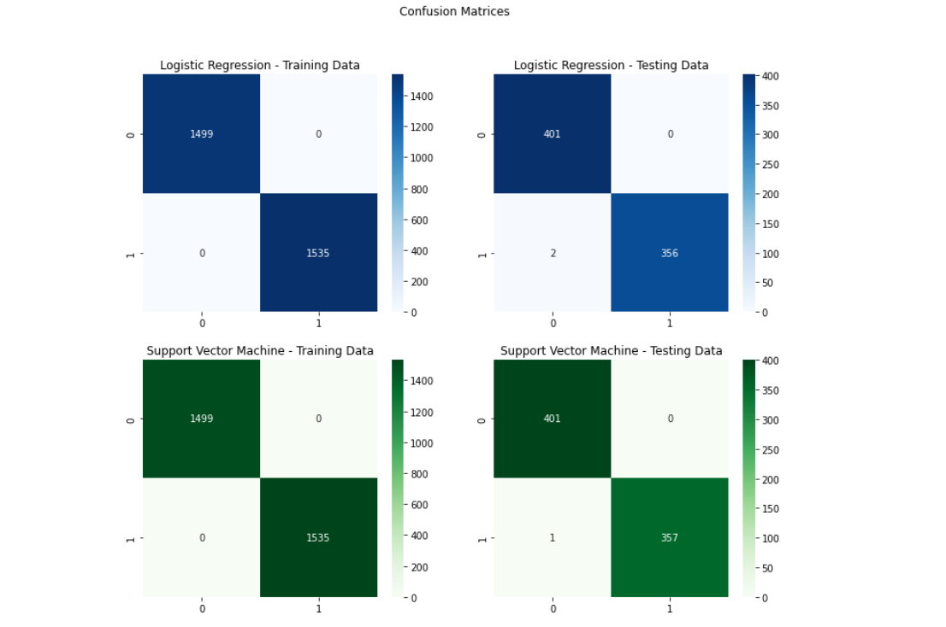
Output and Visualization (Contd.)
Confusion Matrix: -

Slide 19
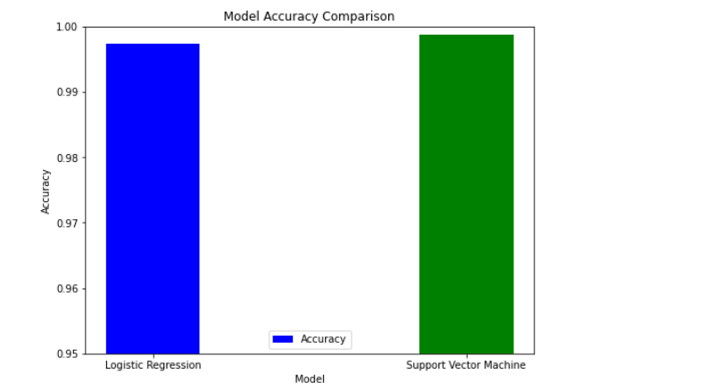
Output and Visualization (Contd.)
Bar Graph: -

Slide 20
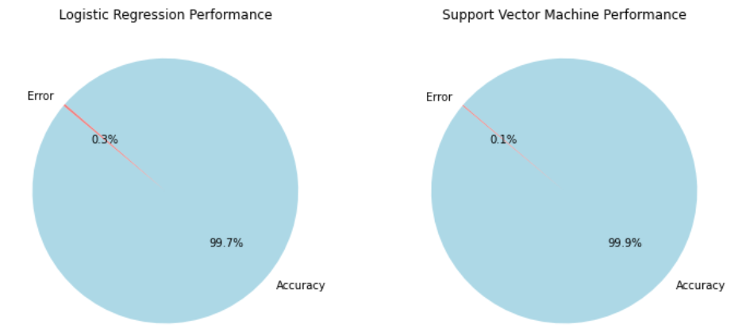
Output and Visualization (Contd.)
Pie Chart: -

Slide 21
Conclusion and Result
We were successfully able to train both our SVM and Logistic Regression models successfully using the training data.
The models were then successfully able to classify almost all the data points/images correctly as either fracture or normal using the testing image dataset where it performs predictions on completely unseen data.
It was observed that for our given dataset, both the models performed exceptionally well but SVM (99.86%) performed slightly better than Logistic Regression (99.73%).
The Confusion Matrixes, Bar Graph and Pie Charts were plotted for Visualization.
So we were able to address our final objective of classifying and detecting abnormalities in the human vertebral column using the proposed models with satisfactory results.

Slide 22
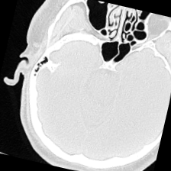
Thank You

